Slide 1
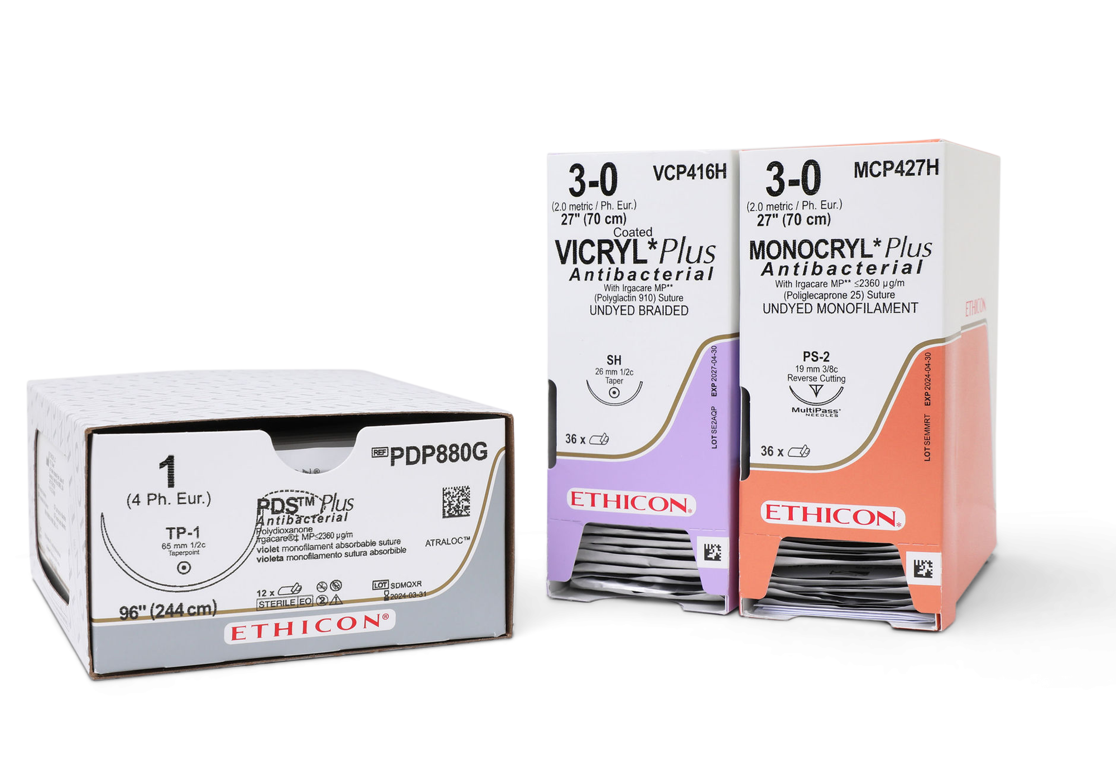
Understanding Sutures
What a minefield!
Todays Training Session:
Notes:
Hello, my name is ……………. From Ebrington Medical. Welcome to our training session where we’ll be looking at how to understand sutures.
If you aren’t already aware there are literally hundreds if not thousands of sutures out there with all different material, thread and needle combinations.
Audience Question: Does anyone here today have a basic understanding of the suture combination they are requesting when ordering a suture?
Join in as we break down the suture configurations so that you can choose the right suture for the procedure or use you have in mind.
For the purpose of this training session we’ll be demonstrating using the johnson & johnson ethicon suture range.

Slide 2
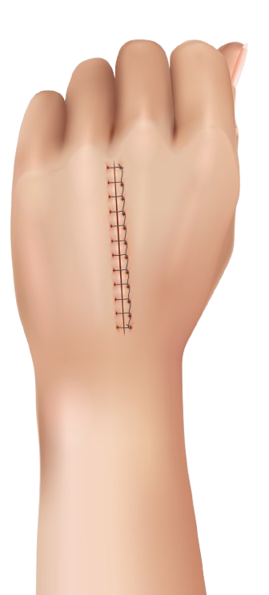
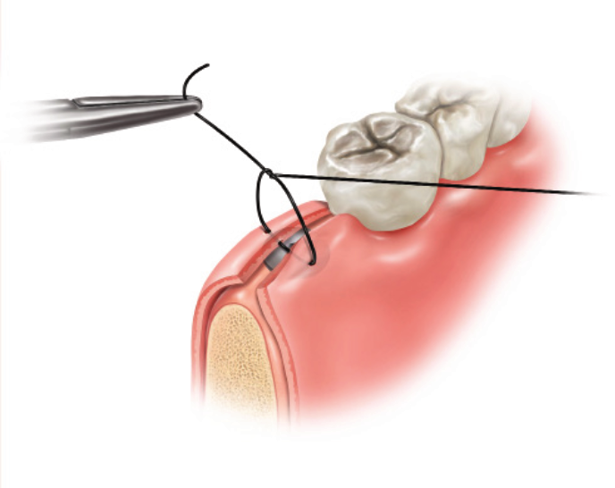
Suture Material Type
Absorbable
Non-Absorbable
Notes:
The first thing you need to know is that sutures are divided into two categories. Absorbable and non-absorbable.
Audience Question: Can anybody suggest where on the body an absorbable suture could be used? And a non-absorbable suture?
Absorbable sutures are typically used for internal tissues that don’t require long-term support for example oral suturing after tooth removal.
Whereas, non-absorbable sutures are used for external closures or tissues requiring long-term support such as skin closure and tendon repair.

Slide 3
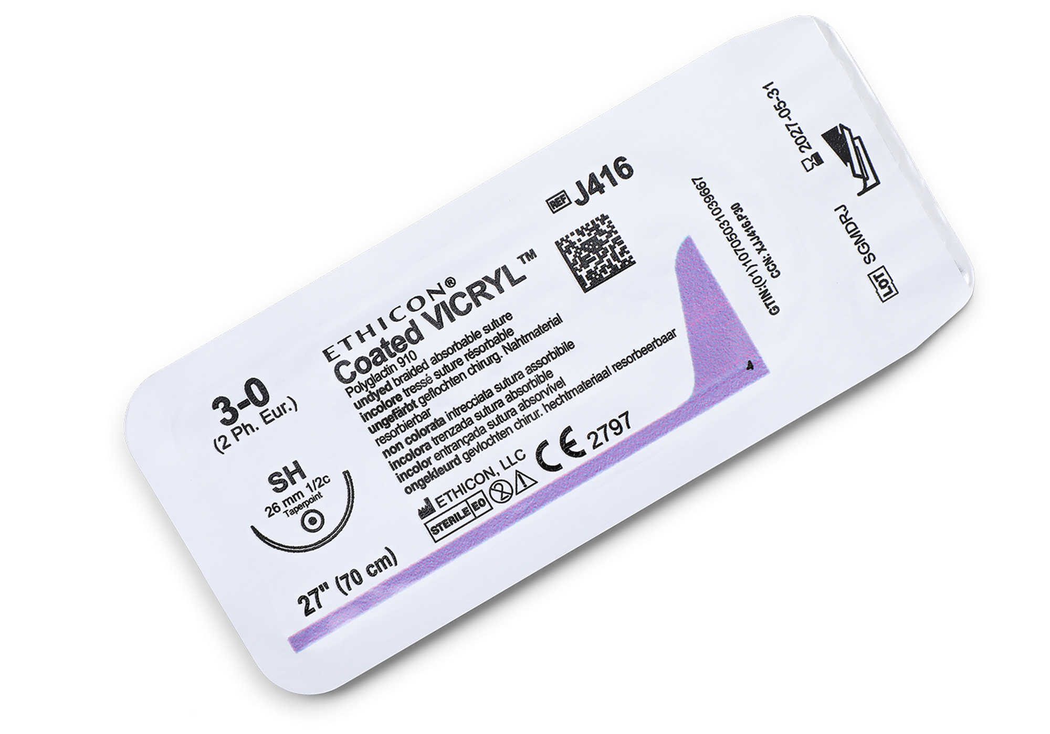

Notes:
Now all the details regarding any J&J suture are printed on the box end and on the individual sutures packets inside.

Slide 4
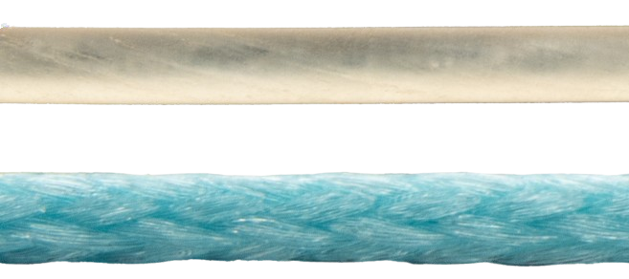
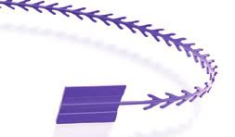
Suture Structure
Monofilament
Braided
Stratafix
Notes:
Up next is, suture structure.
Again, this is divided into two categories and refers to how the thread is made. There are monofilament sutures, where the suture is made from single strand, and then there are braided multifilament sutures where the thread is made from braided or twisted fibres.
Monofilament sutures are known to glide easier through skin whilst braided sutures are easier to handle and knot securely.
Both type of sutures may also be dyed for visibility.
Johnson and Johnson have added what they call stratafix sutures to their range – essentially the suture cable tie. Has anyone heard of or used this suture yet?
This is a barbed monofilament which has been cut from the material with integral anchors and has been developed so surgeons can close wounds without the need for knots.

Slide 6
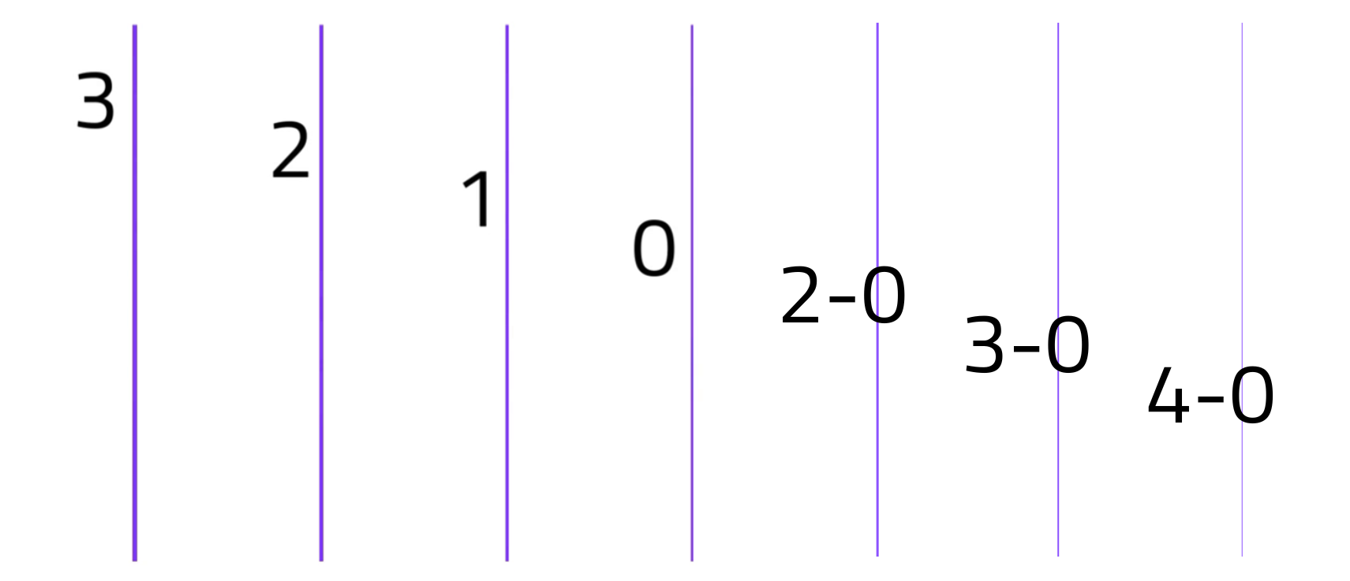
Suture Guage (Thread Diameter)
Suture USP
Notes:
Now we come to the suture thread diameter which is given the term Guage.
This is indicated by the U.S.P gauge shown on the box, referring to the United States Pharmacopeia’s classification of sutures.
Using the USP system, suture diameter is described from 7 (largest) to 11-0 (smallest).
The numerical USP system worked well when there was only a few larger suture materials (size 1, 2, 3, etc..), but as technology allowed for smaller threads to be constructed the number system became confusing. So hyphenated numbers are used for threads with a diameter less than 1. 1-0 stands for size 0, 2-0 is size 00, 3-0 is 000,10-0 is ten zeros and so on.
The nearer to a whole number the gauge, the thicker the tread and the better the tensile strength. The larger size suture gauge material is used for tendon and skin repair whilst the smaller size suture gauges are used for precision procedures such as microsurgery.

Slide 7


Notes:
Sutures have their own unit of measure however, this can be translated into mm or fractions of a mm
Ph. Eur. stands for the European Pharmacopoeia
So for the exact diameter in millimeters, simply times the Ph. Eur. by 0.1mm
👉 USP 3-0 = Ph. Eur. 2 metric x 0.1mm≈ 0.20 mm

Slide 8
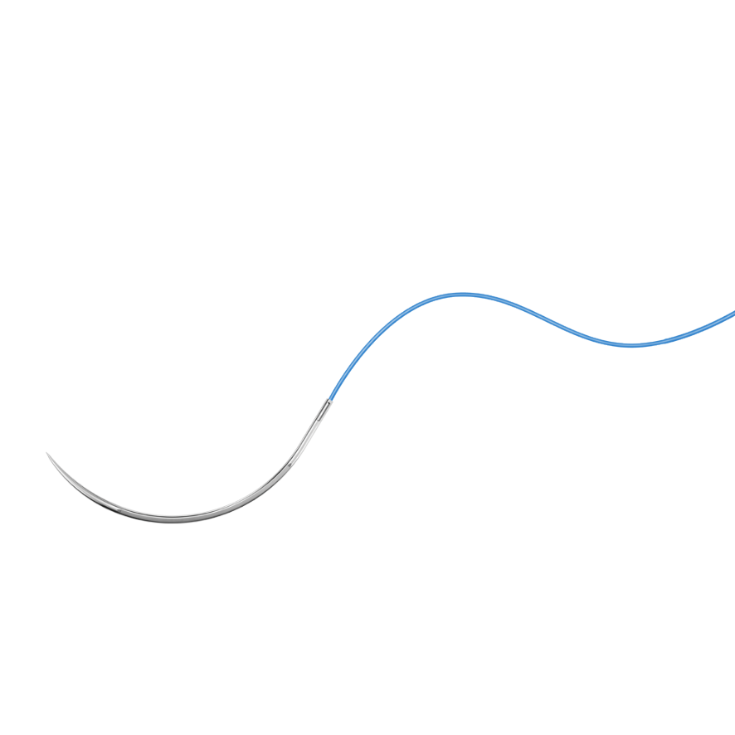
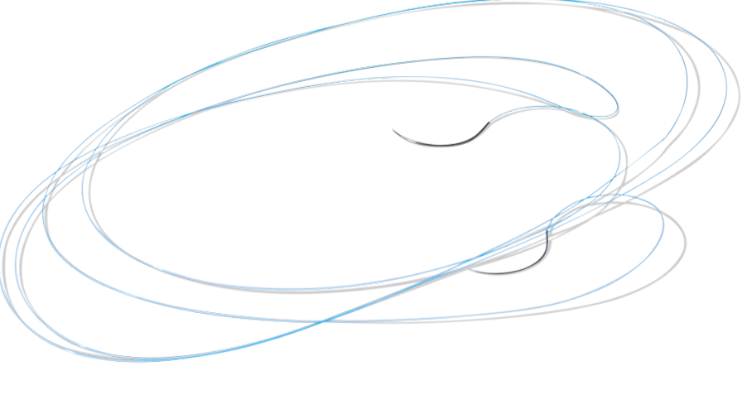
Suture Length
Notes:
Number 4. Suture Length
This is fairly self-explanatory, put simply it is the thread length and it can vary quite dramatically between sutures depending on their use.
So to give you an idea, anything between 30cm and 1.8m in length is pretty common.

Slide 9


Slide 10
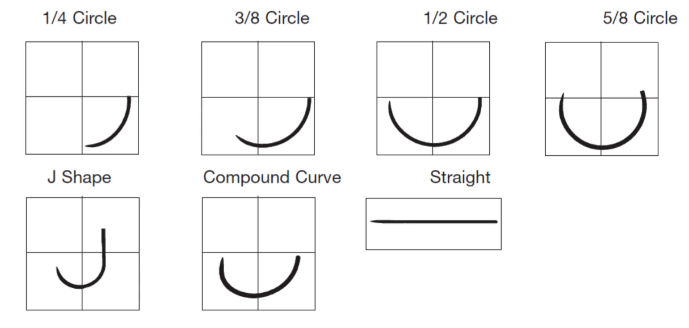
The Needle – Needle Shapes
Notes:
Now we come to one of the more complex elements– the needle.
We’ll take this one step at a time, starting with the shape of the needle body
Suture needles come in a variety of shapes including circular, straight and curved needles – each for an intended use

Slide 11


Slide 12
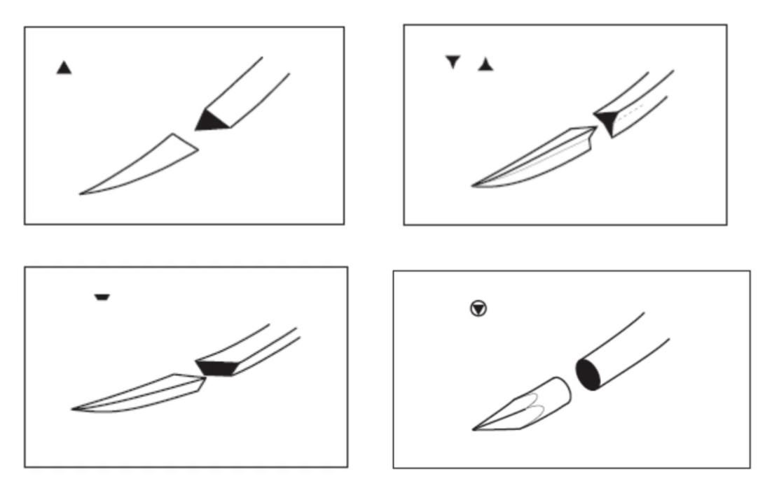




The Needle – Needle Point
Notes:
Needles are also classified according to their cutting types. Here are a few examples
The cutting type symbols are a representation of their cross-section and this is shown in the symbol

Slide 13

Notes:
Taperpoint – sharp point, wide body

Slide 14
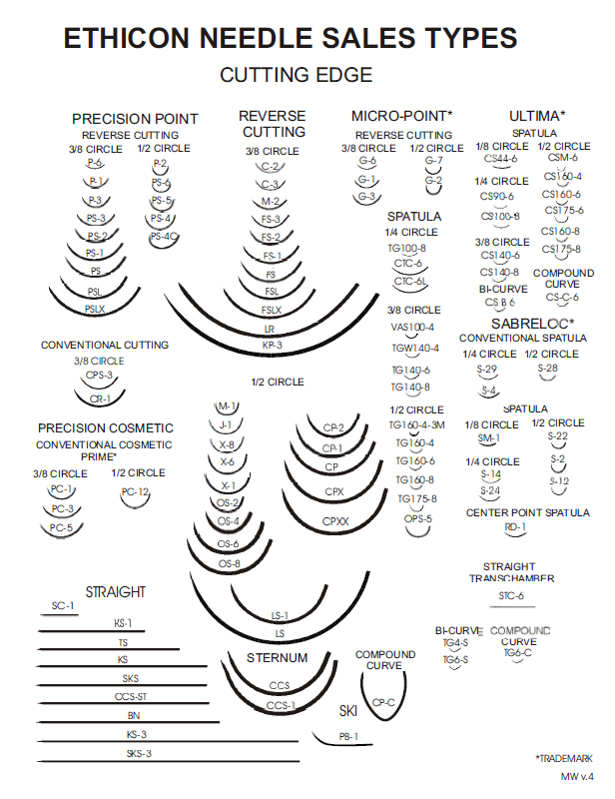
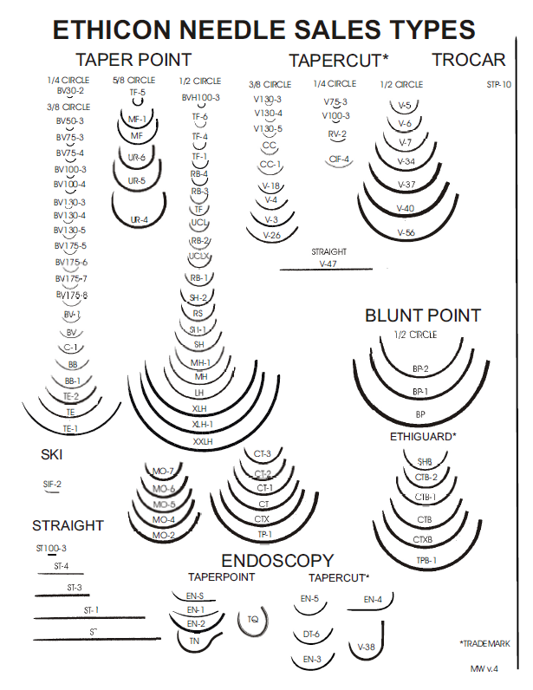
The Needle – Needle Size
X mm
Notes:
Needles are given a specific length
Measured in millimeteres along the curvature (outer size)

Slide 15

Notes:
Now the image you see on the suture packaging is a 1:1 scale depiction of the needle.
The outline is the exact size

Slide 16
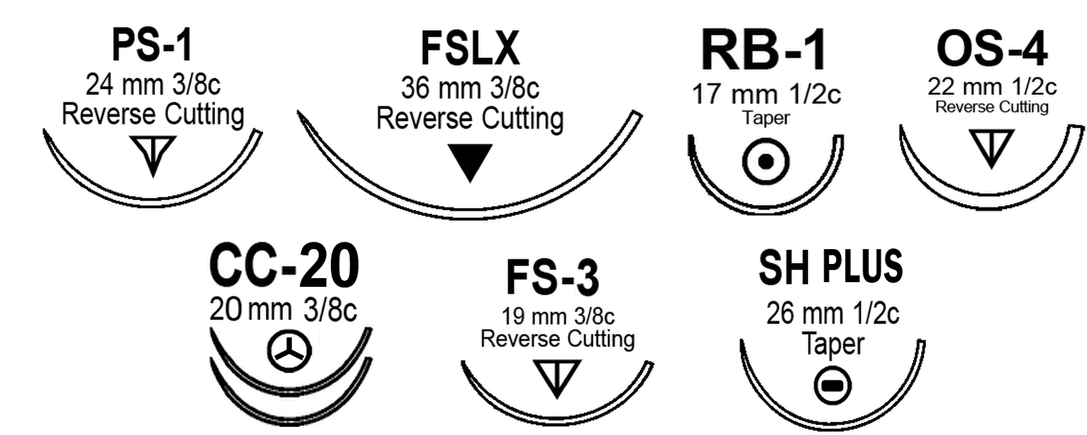
The Needle – Needle Cobination Codes
Notes:
The suture needle combination of shape, size and cutting point and subsequently is given each a unique code based on its intended purpose.
That unique code will always have the same shape, size and cutting point variable fixed regardless of what suture its on.

Slide 17





Slide 18
The Needle – Needle Uses
Needle Code | Needle Meaning
BB | Blue Baby
BV | Blood Vessel
C | Cardiovascular
CP | Cutting Point
FS | For Skin
M | Muscle
PC | Precision Cosmetic
SC | Straight Cutting
TN | Trochar Needle
X | Exodental
Needle Code
PS
U
RD
CE
Needle Meaning
Plastic Surgery
Urology
Renal Detachment
Cutting Edge
Notes:
Another thing to note is that the needle codes are derived from their intended procedure use.
Look at these examples.
Audience Question: Can you guess what these needle codes mean?

Slide 19

Notes:
SH here stands for Small Half

Slide 20
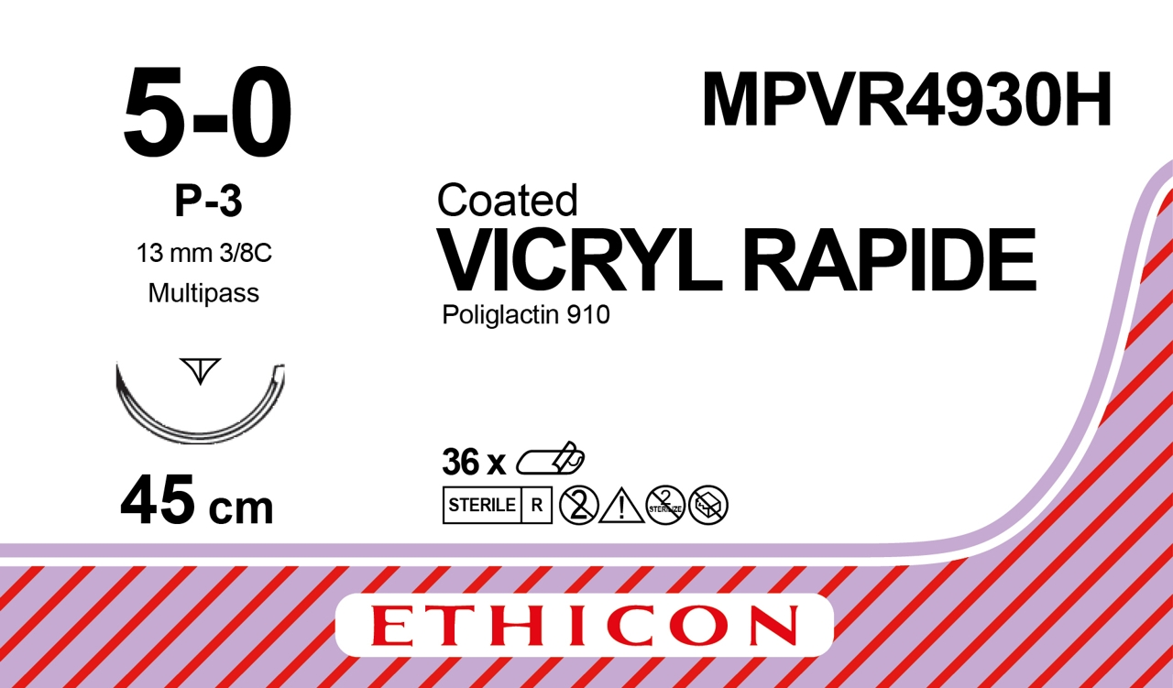
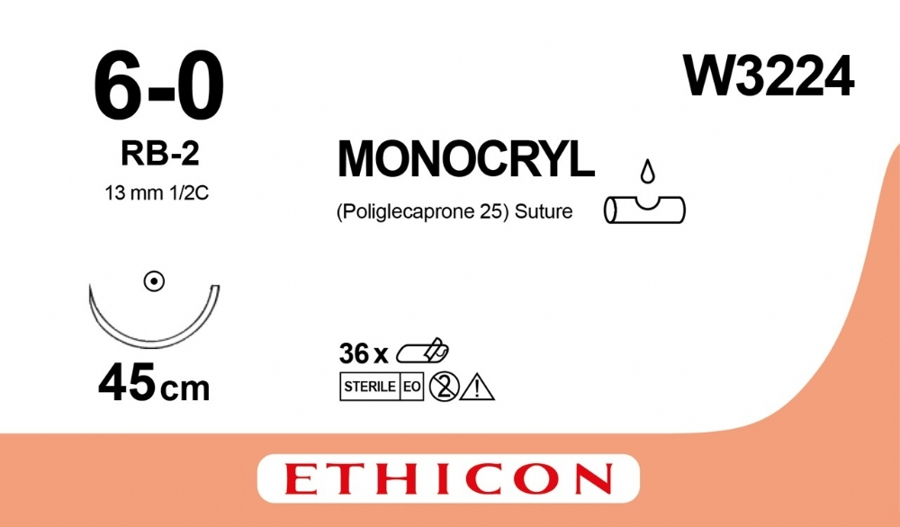
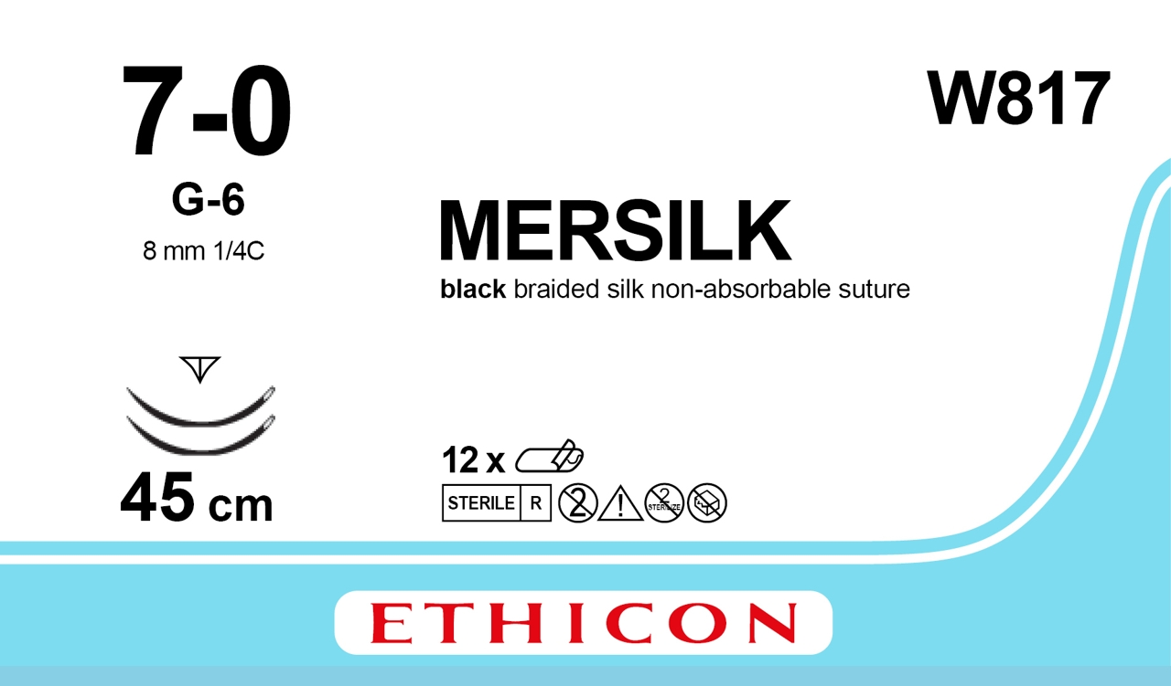
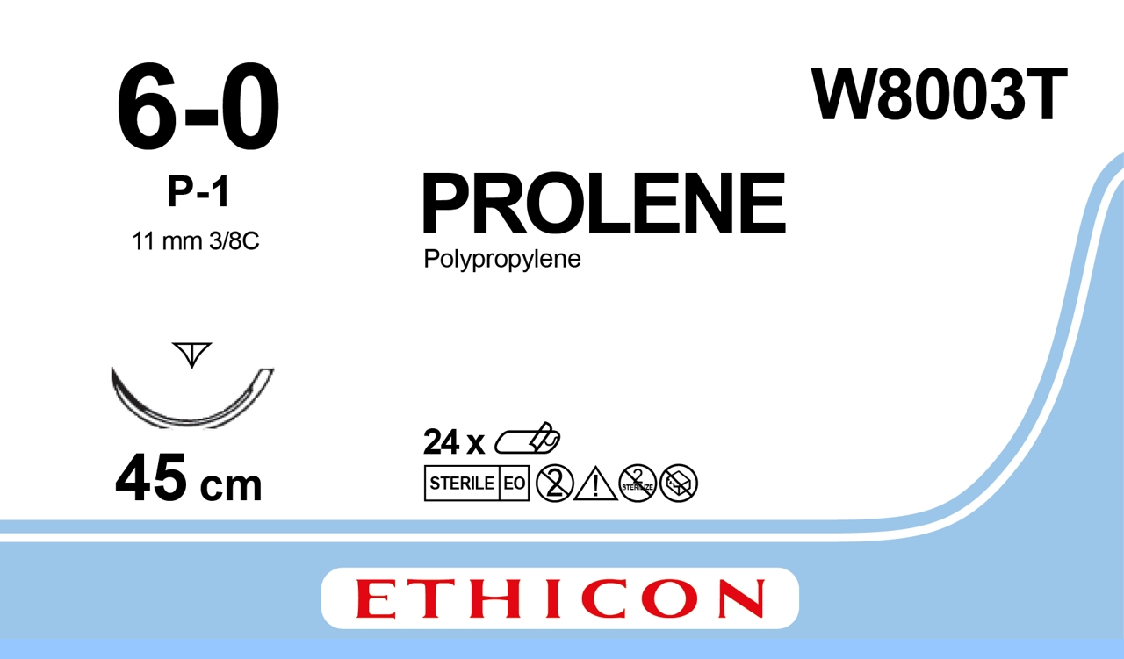
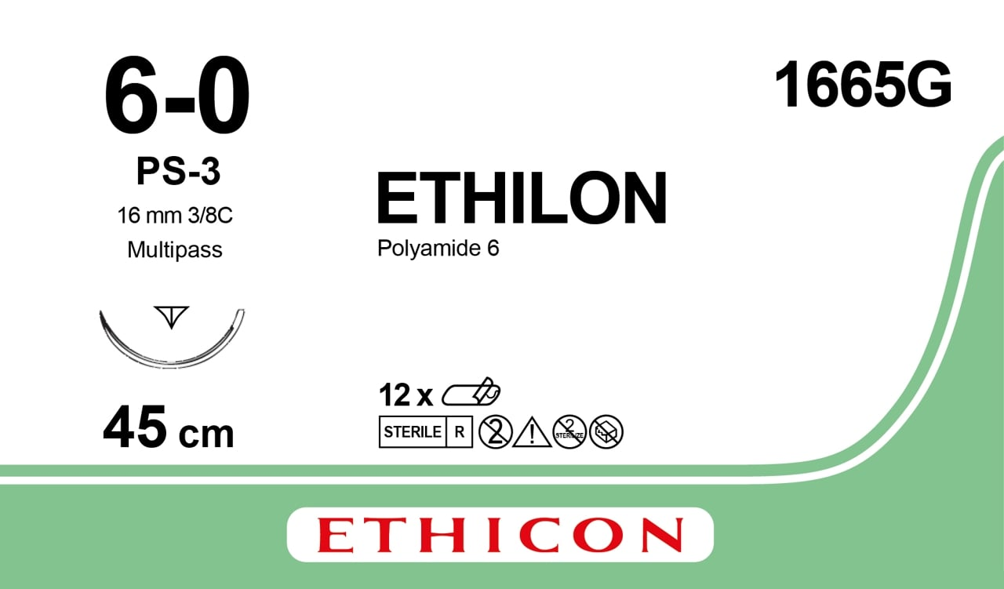
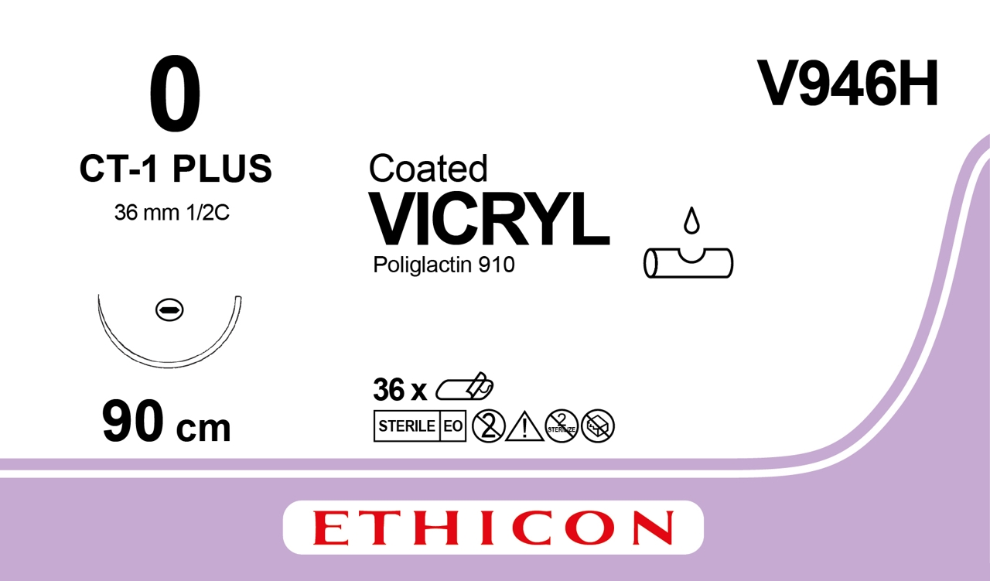
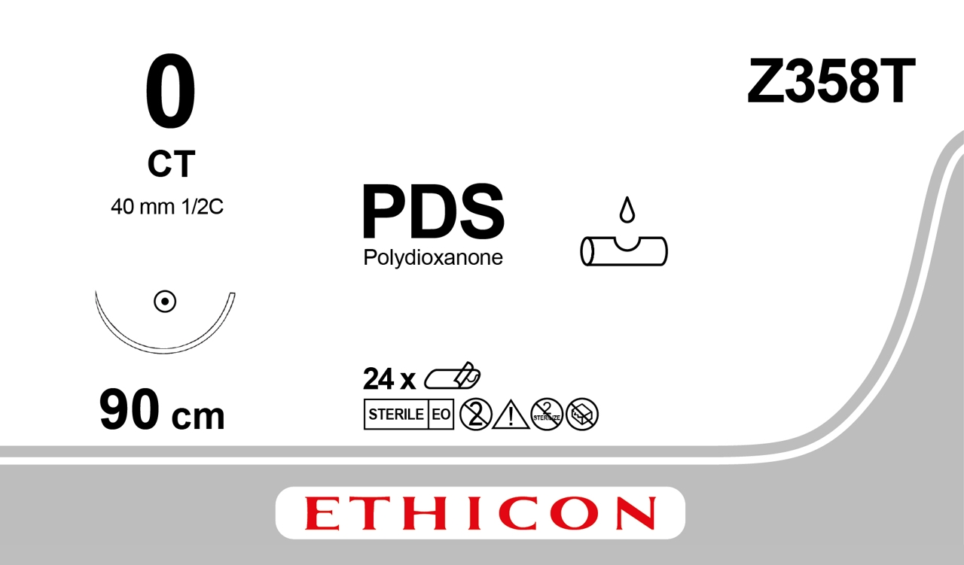
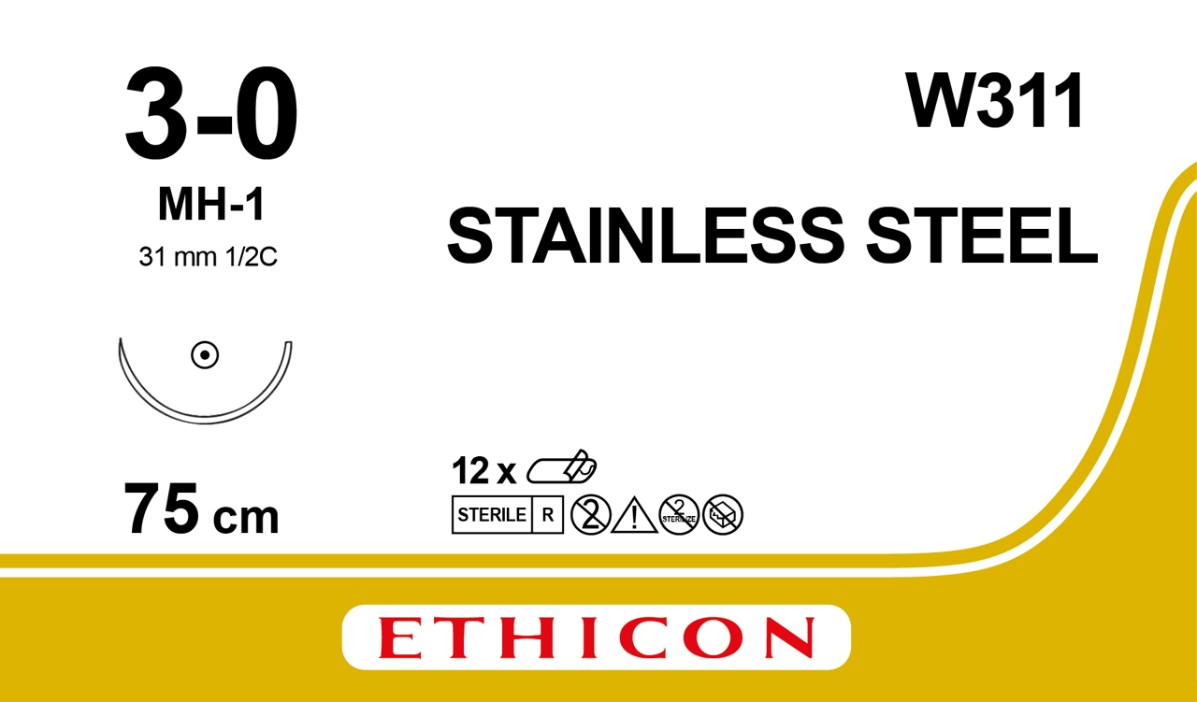
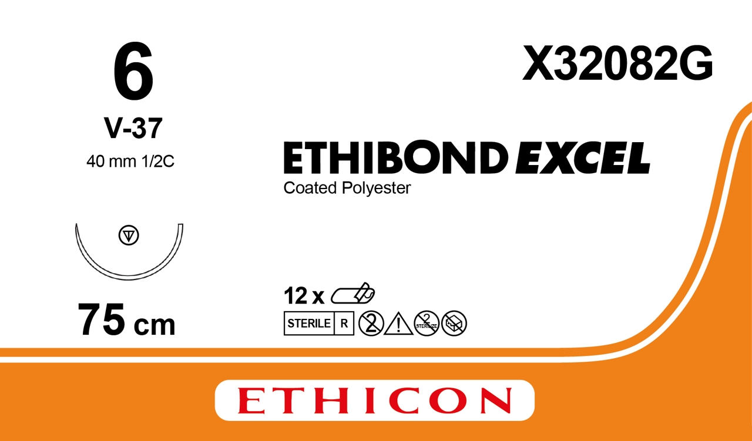
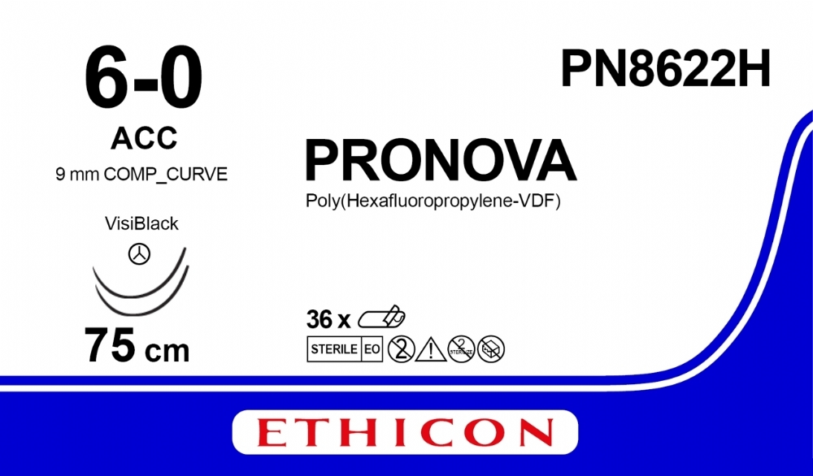
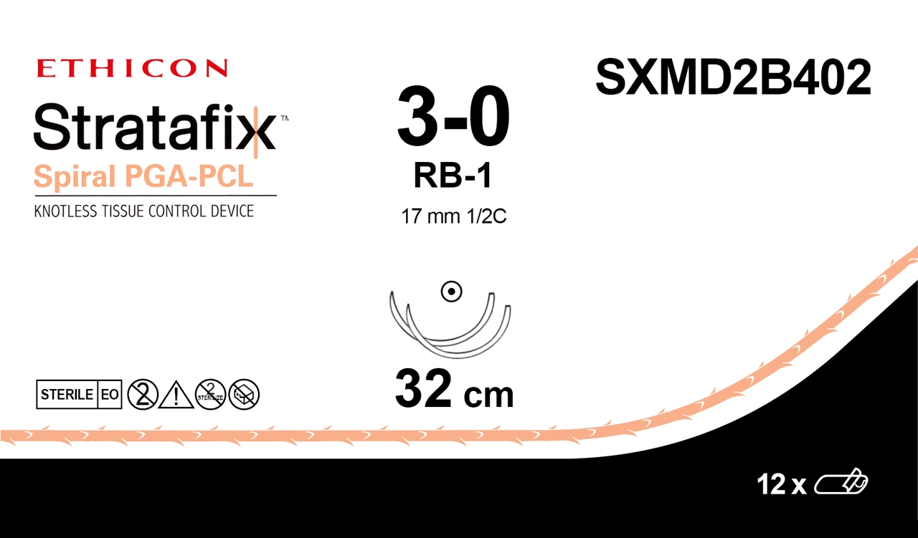
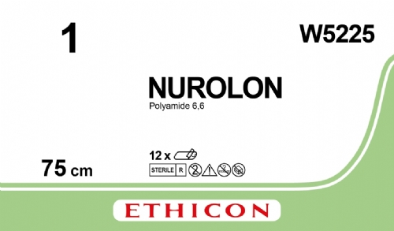
J&J Suture Types
Absorbable
Non-Absorbable
Notes:
Here we have a snapshot of the various suture brands from J&J.
Audience Question: Can anyone pick out the 2 sutures made with natural materials?
2 Natural Sutures: Stainless Steel and Mersilk (made from the cocoons of the silk worm Bombyx Mori)
The others are synthetic-based using materials such as nylon, polyester and polyglactin
Again, different uses for each, and varying breaking strength retentions

Slide 21
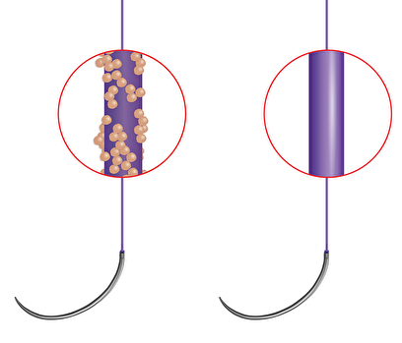
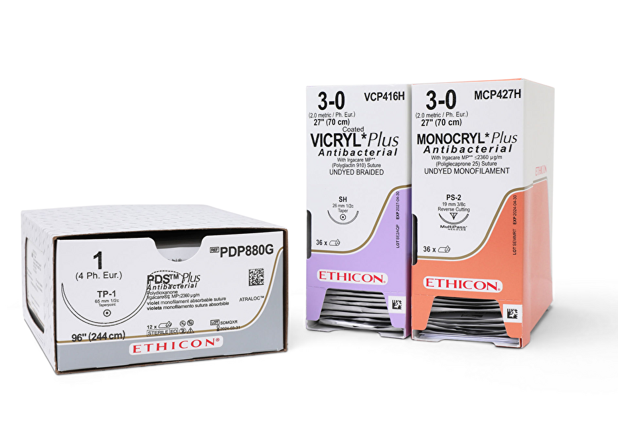
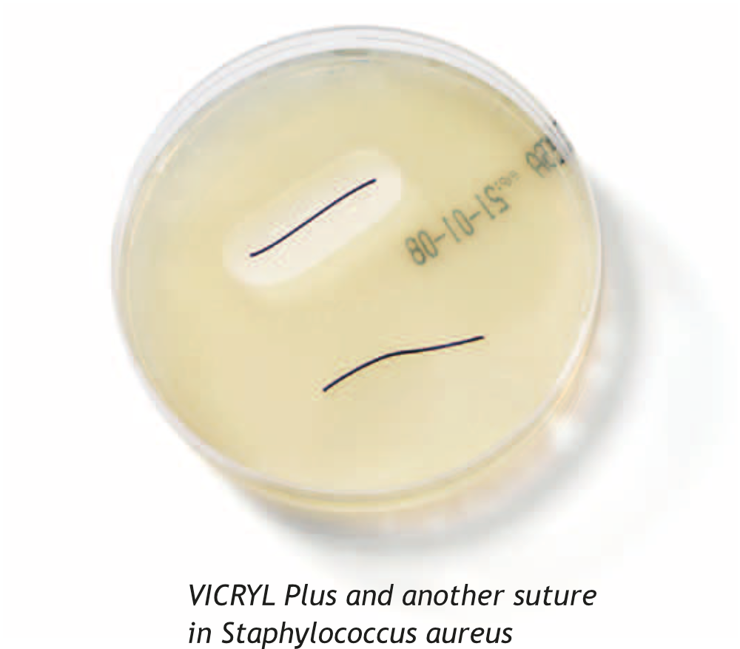
Antibacterial Sutures
Ethicon Plus Suture Range
Notes:
With the risk of SSI’s (Surgical Site Infections), particularly with vulnerable tissue such as bowels, bladders and even skin. J&J have developed an antibacterial range with 3 of their absorbable sutures.
Known as Plus Sutures, it simply is an antibacterial coating of Triclosan (TRY-kluh-san) on top of the suture so that MRSA and other bacteria are inhibited at the wound site - Extensive clinical data shows a 28% reduction in SSI risk
Sutures in the range presently: PDS Plus, Vicryl Plus, Monocryl Plus

Slide 22
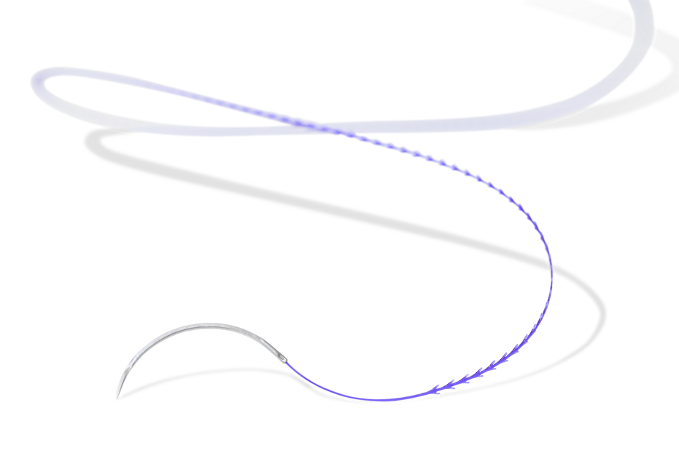
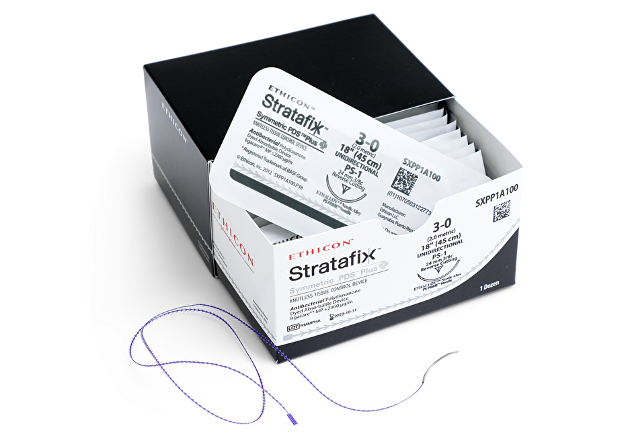
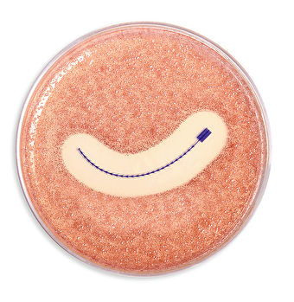
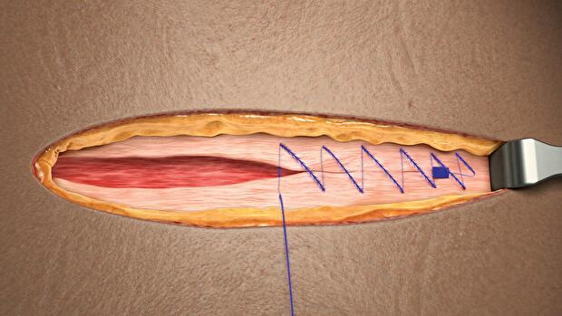
Stratafix Sutures
Knotless Tissue Control Device
Notes:
STRATAFIXTM Knotless Tissue control devices, are monofilament sutures with fixating barbs.
They allow for tension to be maintained on each pass for more security, consistency, and efficiency than traditional sutures.
Other Benefits:
Stratafix sutures typically made with the Plus suture materials
Faster closing of wounds – reduced blood loss
Provides a greater strength retention over time

Slide 23


Slide 24
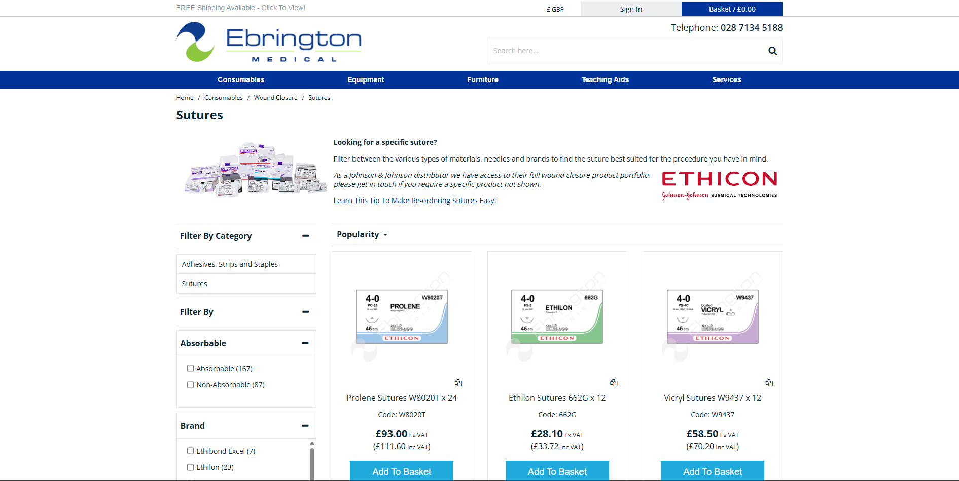
Select Sutures Online
www.eb-med.com - Try our product filter!

Slide 25
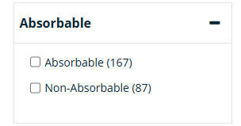
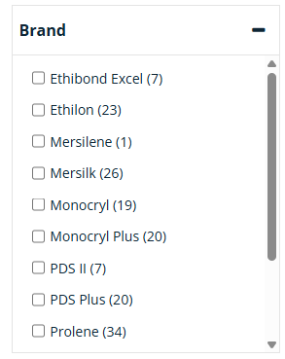
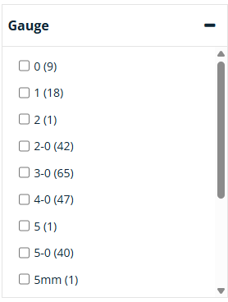
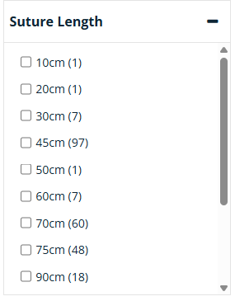
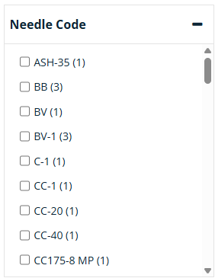
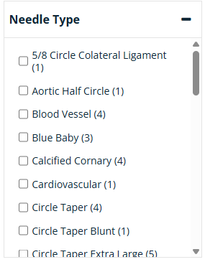
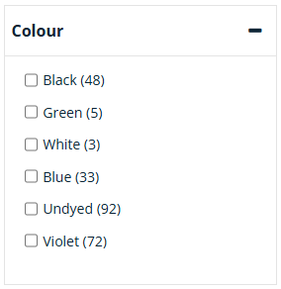
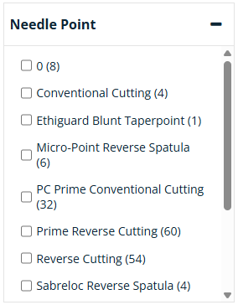
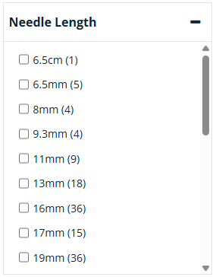
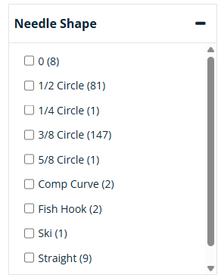
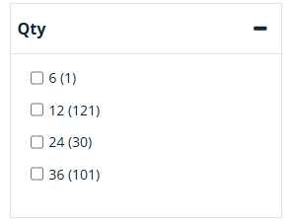
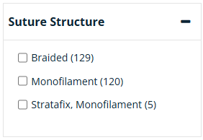

Slide 26

The End
Thank You For Your Time
Any Questions?

